Slide 1
Big Data Project
Big Data
Guided By:
Orren Johnson
Prepared By:
Vidhi Patel (N01426021)
Jinal Patel (N01495566)

Slide 2
Super Store Data Analytics
Following our analysis of the
superstore's sales and customer data,
we made the following
conclusions about their business
Source: https://www.kaggle.com/datasets/vivek468/superstore-dataset-final

Slide 3
Super Store Data Analytics
For this analysis , We have used 2 main data:
ORDER
CUSTOMER
Order details to hold the record of orders associated with customer details by customerID
Customer details which contains all the information of customer

Slide 4




Used Technologies of Big Data
HDFS
It is used to scale a single Apache Hadoop cluster to hundreds (and even thousands) of nodes
Hive 2.0
Hive allows users to read, write, and manage petabytes of data using SQL
Zeppelin Notebook
It is used for Visualization of the data
HBase Shell
It enables random, strictly consistent, real-time access to petabytes of data

Slide 5
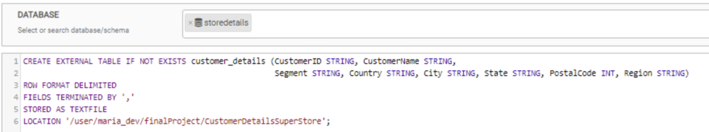
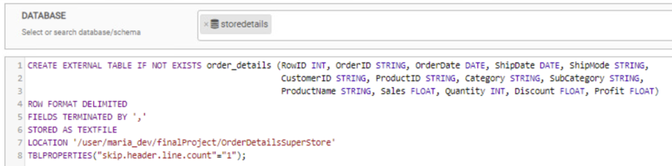
Table creation using Hive

Slide 6
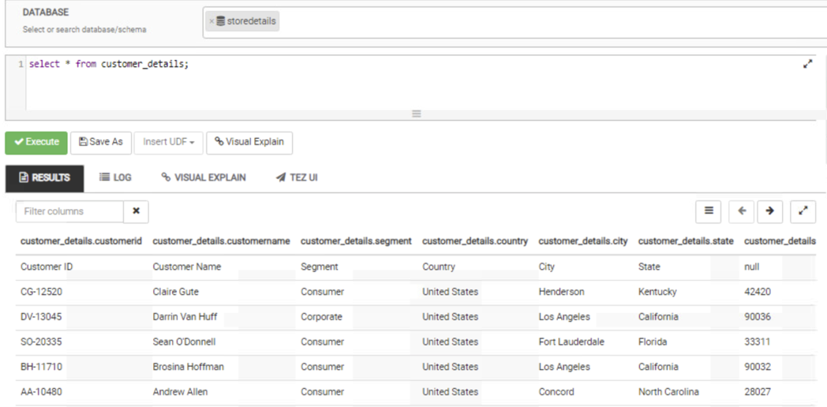
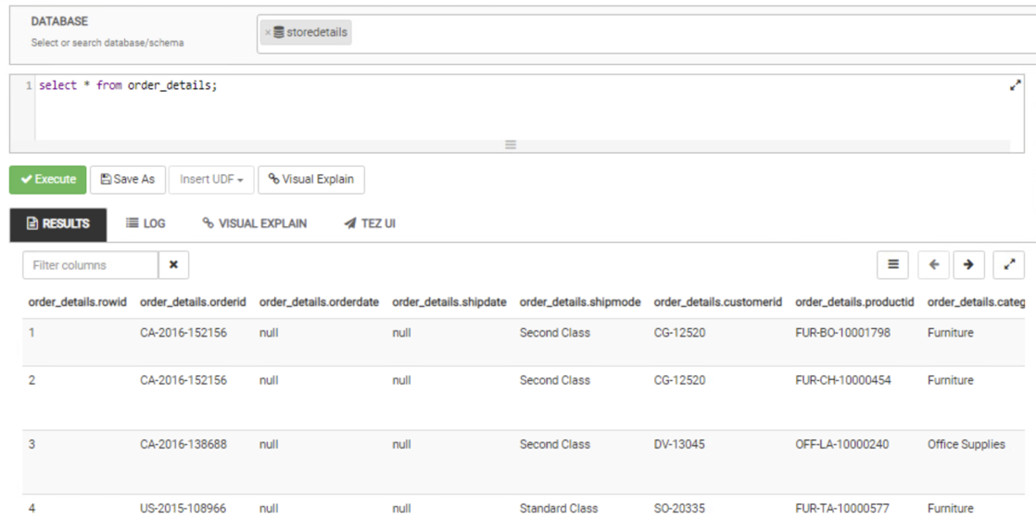
Data Representation In Hive

Slide 7
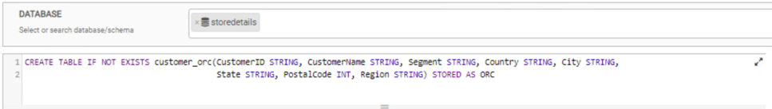


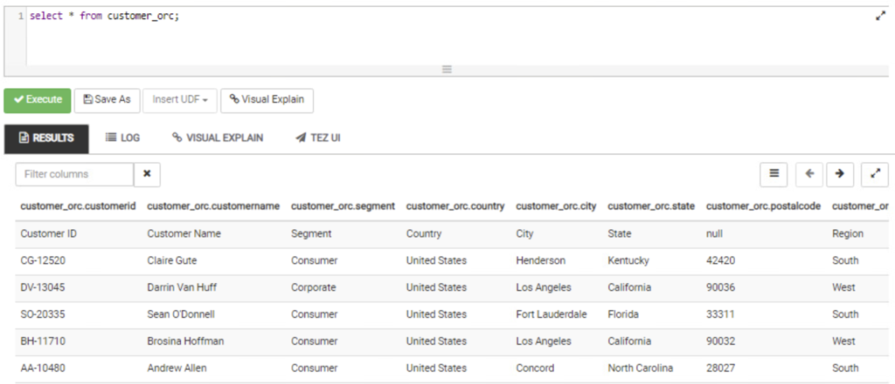
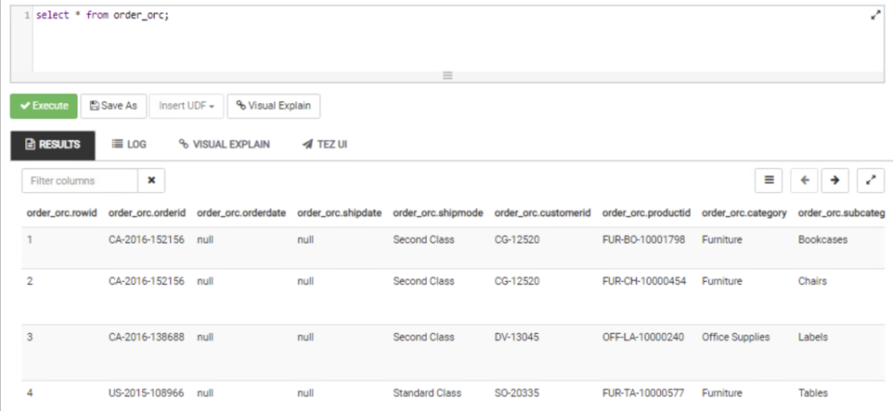
Internal table creation in Hive
Loading Data
Verification of Data

Slide 8
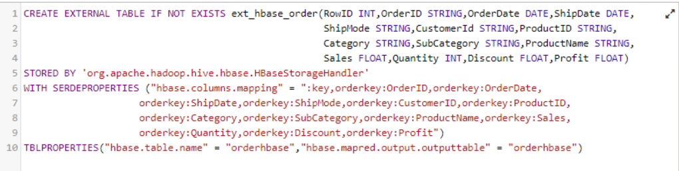
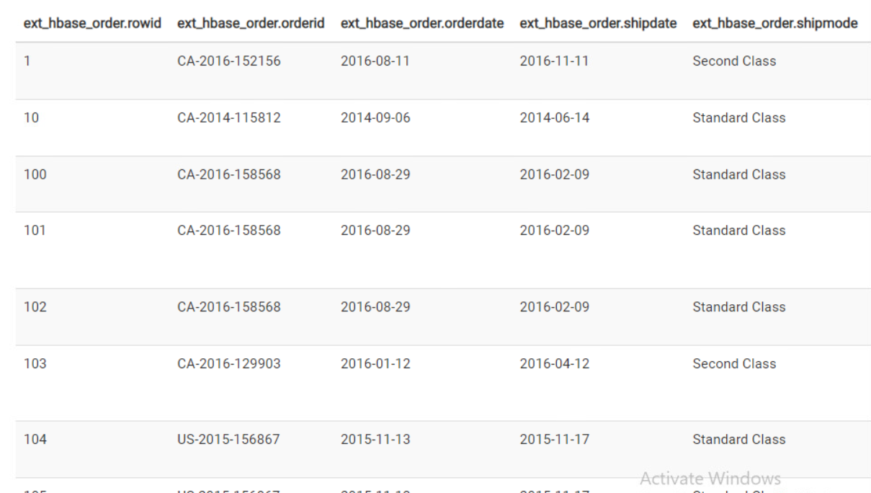
Data Mapping of table in HBase using Hive
We have created Table in HBase using shell and then map the data using external table in hive
After that inserted the record in external HBase table using internal table of hive.

Slide 9
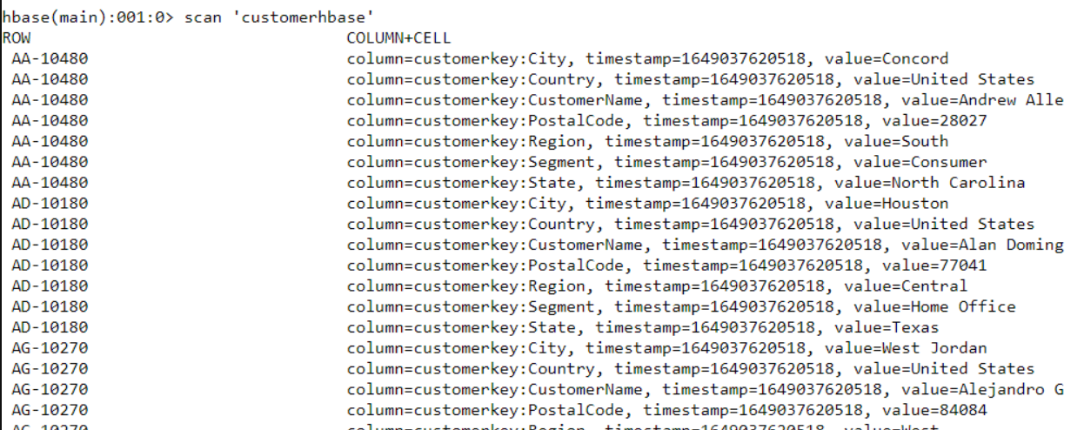
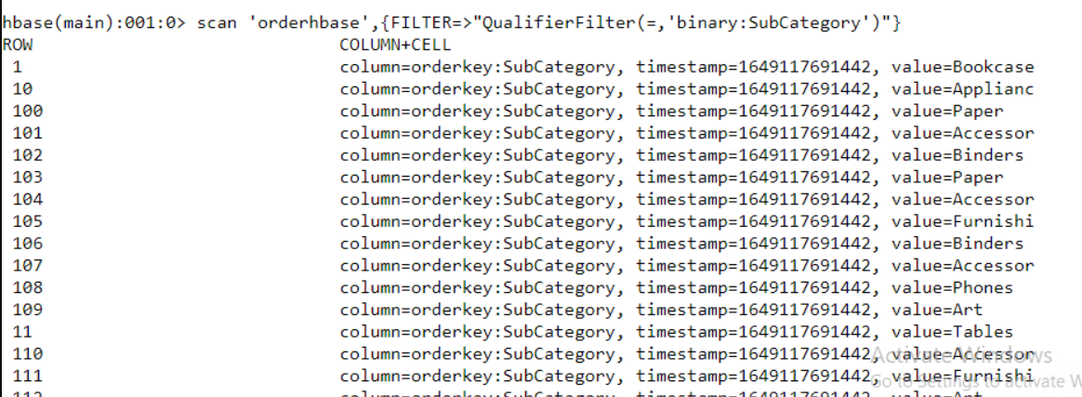
Data representation in HBase

Slide 10
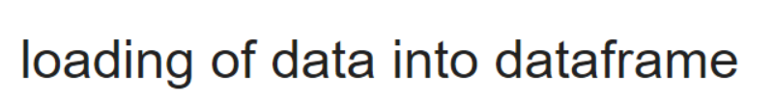
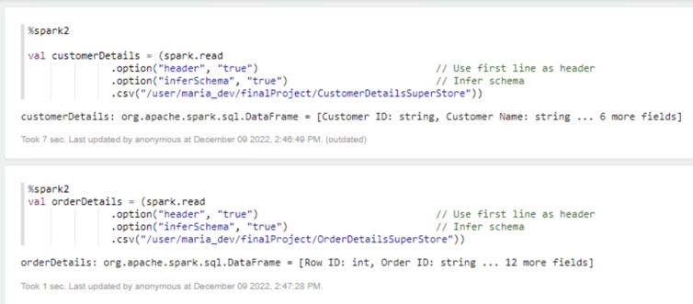
Data Analysis using Zeppelin Notebook
In our Zeppelin notebook , we have loaded “customerdetails” & “orderdetails” data frame into zeppelin .

Slide 11
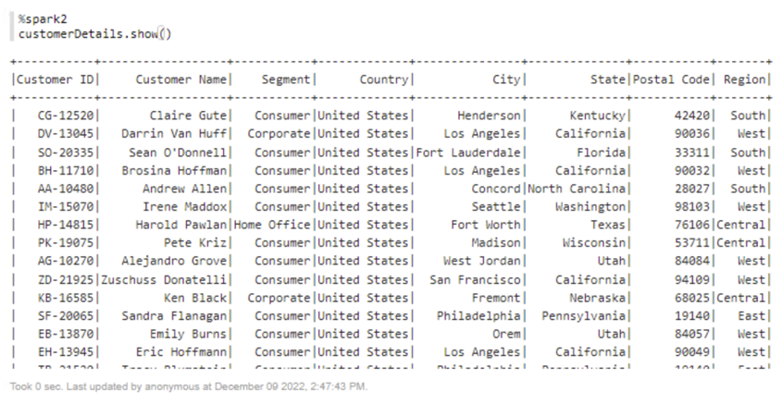
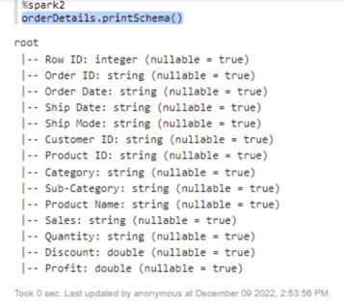
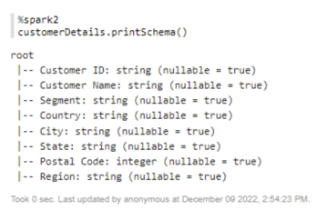
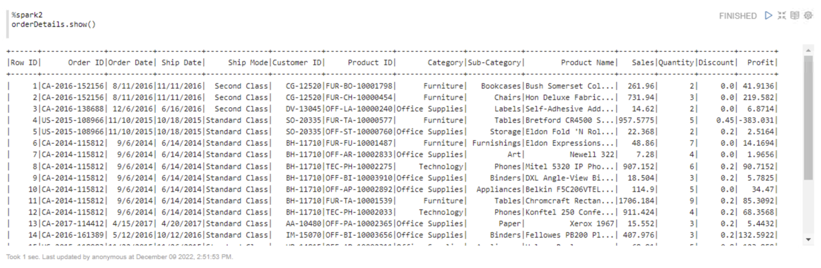
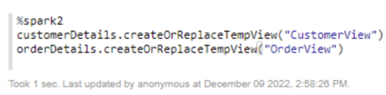
Visualization of schema & data frame
Printing of Dataframes Schema
Displaying of Dataframes
Creating views on dataframes

Slide 12

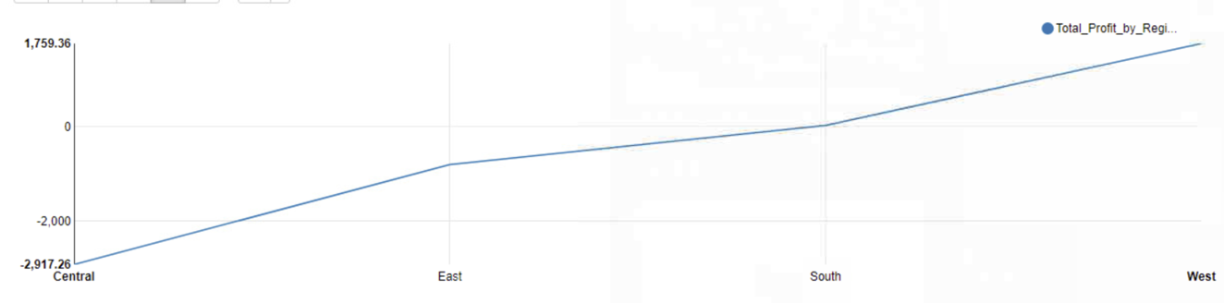
Insights of our analysis
Showing total profit by each region using line graph.
As per the analysis , West region has the highest profit among all regions and in the central region more improvement is needed to gain the more profit

Slide 13
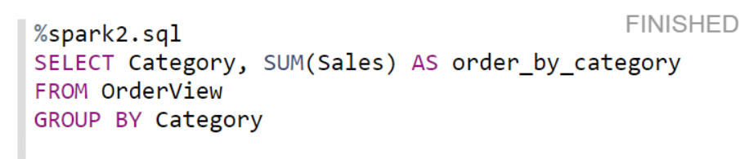
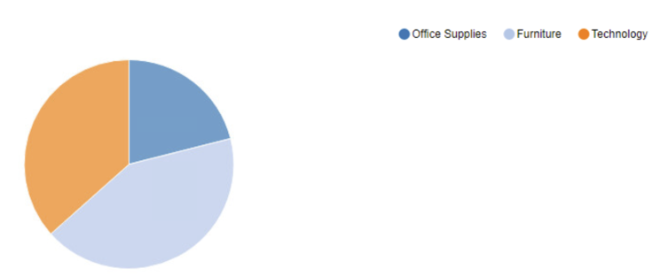
Insights of our analysis
Showing total Sales by each category using pie chart.
According to chart, Furniture is the most demanding category for the superstore in terms of sales.

Slide 14

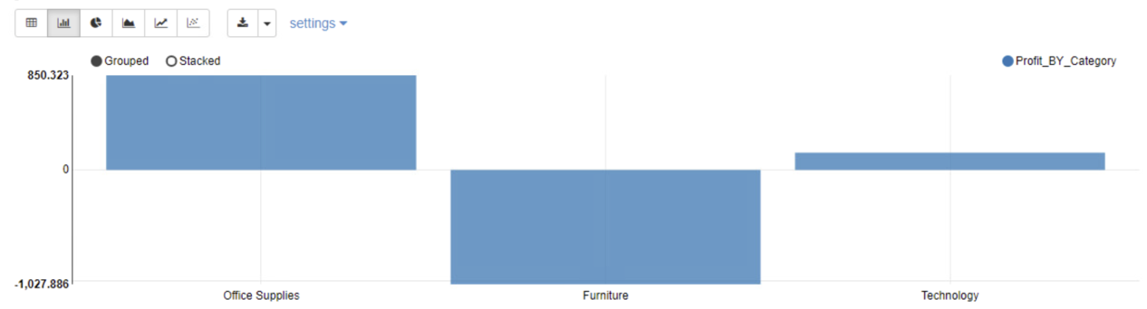
Insights of our analysis
Showing total Profit by each category using bar chart.

Slide 15
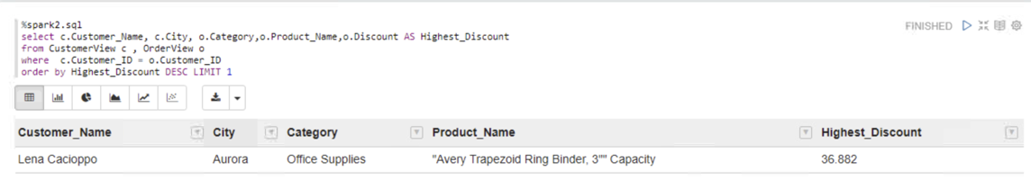
Insights of our analysis
Displaying the customer details who has got the highest discount

Slide 16

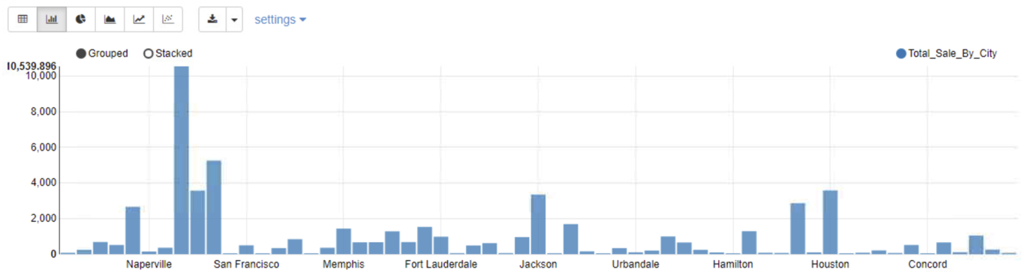
City of Naperville is the city with highest sales
City of Naperville is the cornerstone for overall revenue of super store from all branches.
Insights of our analysis

Slide 17
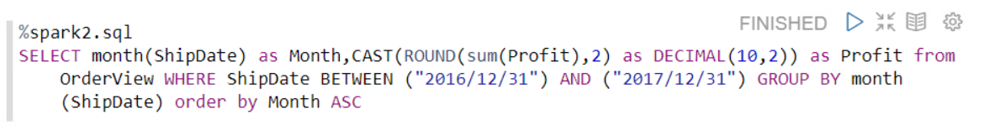
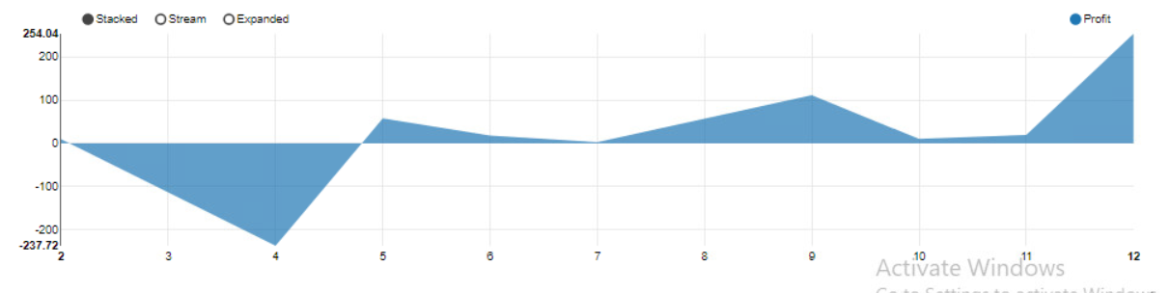
Insights of our analysis
In the December month super store gained highest Profit.
Apart from the first five-month overall performance is good in terms of profit.
Superstore need to change the strategy till April month by providing some offers in order to increase the Profit

Slide 18
Conclusion
We used joins on the tables contained in the Zeppelin notebook, HIVE 2.0, HDFS, and HBASE to gain data visualization into graphs.
We were able to view the data that is present in multiple environments in BIGDATA by using all of these platforms

Slide 19
THANK YOU

